Slide 1
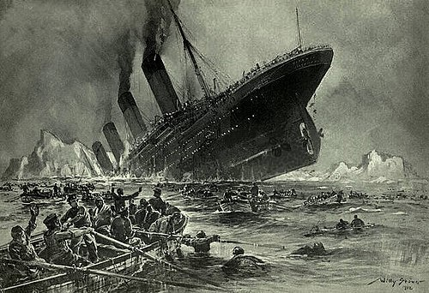
Titanic Passenger Survival Analysis
Insights and Key findings
by Tanmay Kumar Chaki

Slide 2
Aim of Analysis
The aims of the analysis are mentioned below
Analyze how different features like age, gender, passenger class, etc., affected the chances of survival on the Titanic.
Handle missing values, explore data patterns, and visualize important trends within the Titanic dataset.
Develop machine learning models to predict whether a passenger would survive or not based on their characteristics.

Slide 3
Technology Used in this Analysis.
1. Programming Language:
Python
2. Libraries/Packages:
Pandas – for data manipulation and analysis
NumPy – for numerical operations
Matplotlib – for data visualization
Seaborn – for advanced data visualization
Scikit-learn (sklearn) – for building machine learning models
3. Platform:
Jupyter Notebook – for writing and running the analysis interactively

Slide 4
About The Dataset
Dataset Name: Titanic - Machine Learning from Disaster (commonly from Kaggle)
Description: This dataset provides information about the passengers aboard the RMS Titanic, which tragically sank after hitting an iceberg in 1912.
Objective: Predict whether a passenger survived or not, based on features such as age, gender, class, and fare paid.
Main Features:
PassengerId – Unique ID for each passenger
Pclass – Ticket class (1 = 1st, 2 = 2nd, 3 = 3rd)
Name – Name of the passenger
Sex – Gender
Age – Age in years
SibSp – Number of siblings/spouses aboard
Parch – Number of parents/children aboard
Ticket – Ticket number
Fare – Amount paid for the ticket
Cabin – Cabin number
Embarked – Port of Embarkation (C = Cherbourg, Q = Queenstown, S = Southampton)
Target Variable:
Survived (0 = No, 1 = Yes)

Slide 5
Key Factors
1. Gender:
Female passengers were more likely to survive.
2. Passenger Class (Pclass):
1st class passengers had a much higher survival rate compared to 2nd and 3rd class passengers.
3. Age:
Younger passengers (especially children) had better survival chances.
4. Fare Paid:
Passengers who paid higher fares (associated with 1st class) were more likely to survive.
5. Port of Embarkation (Embarked):
Passengers who boarded from Cherbourg (C) had slightly higher survival rates.
6. Family Aboard (SibSp & Parch):
Having siblings/spouses or parents/children on board positively influenced survival chances compared to traveling alone.

Slide 6
Key Insights
1. Gender Impact:
Females had a significantly higher survival rate compared to males.
2. Class Matters:
Passengers in 1st Class were much more likely to survive than those in 2nd or 3rd class.
3. Age Factor:
Children (especially under 10 years old) had a higher chance of survival compared to adults.
4. Embarkation Point Influence:
Passengers who embarked from Cherbourg (C) had slightly higher survival rates.
5. Family Connection:
Passengers traveling with family members (having non-zero SibSp/Parch values) had a better survival chance compared to those traveling alone.

Slide 7
The analysis revealed that gender, passenger class, and
age were the most significant factors affecting
survival chances on the Titanic.
Females, children, and 1st class passengers had notably
higher survival rates.
Building predictive models based on these key features can
effectively estimate the survival of passengers with good accuracy.
Proper data preprocessing, like handling missing values and
feature selection, played a crucial role in improving model performance.
Overall, the study highlights how demographic and
socio-economic factors influenced survival outcomes in historical events.

